Slide 1

CUSTOMER CHURN PREDICTION IN TELECOM INDUSTRY
Mentor
Mr. G. Sankara Rao
Associate Professor
CSE Department
Project Member:
T. Lavanya (21JG1A0560)
Department of Computer Science and Engineering
GAYATRI VIDYA PARISHAD COLLEGE OF ENGINEERING FOR WOMEN
[Approved by AICTE NEW DELHI, Affiliated to JNTUK Kakinada]
[Accredited by National Board of Accreditation(NBA) for B.Tech. CSE, ECE & IT – valid from 2019-22 and 2022-25]
[Accredited by National Assessment and Accreditation Council (NAAC) with A Grade – valid from 2022-27]
Kommadi, Madhurawada, Visakhapatnam – 530048
Academic Batch : 2020– 2024

Slide 2
PRESENTATION OUTLINE
Abstract
Literature Survey
Existing System
Proposed System
Architectural Diagram
Modules
Implementation (Visualization)
Output
References

Slide 3
ABSTRACT
Customer churn analysis and prediction are critical in the telecom sector, where customer retention is paramount. As acquiring new customers often incurs higher costs than retaining existing ones, machine learning techniques and algorithms play a pivotal role in identifying potential churners. This project focuses on building classification models, particularly Decision Tree and Random Forest, for churn prediction. The telecom industry, amidst rapid technological growth, faces the challenge of retaining customers in a landscape filled with diverse subscription-based services. In this project, a machine learning-based churn prediction model is proposed for a business-to-business (B2B) subscription-based service provider within the financial administration domain. The study adheres to the design science methodology, iteratively constructing and evaluating the models using metrics such as accuracy, precision, recall, and F1-score. Given the dataset's imbalance, with a majority of non-churners, two sampling methods, SMOTE and SMOTEENN, are applied to address this issue. The study's results demonstrate the effectiveness of machine learning in predicting customer churn, underlining its usefulness for telecom companies in enhancing customer retention strategies. This research contributes to the ongoing efforts to address the challenge of customer churn in the telecom sector, ultimately benefiting the industry's sustainability and growth.

Slide 4
LITERATURE SURVEY:
In the field of customer churn analysis, a range of prior studies and applications have contributed
valuable insights and methodologies
Smith et al. (2019) developed a predictive churn model that utilized logistic regression to identify at-risk customers, highlighting the practical application of statistical methods in churn analysis.
Moreover, Patel and Gupta (2020) presented a case study of a real-world churn analysis application in a telecom company, emphasizing the importance of practical implementations
Garcia and Rodriguez (2018) explored the use of machine learning algorithms, particularly decision trees and random forests, in predicting customer churn, shedding light on the significance of algorithm selection
In addition, Chen and Wang (2017) introduced a novel approach for sentiment-based churn analysis, recognizing the role of customer sentiment in predicting churn behavior
These prior studies collectively lay the foundation for our research and underscore the evolving landscape of customer churn analysis models and their real-world applications

Slide 5
EXISTING SYSTEMS:
Manual Analysis:
Description: Traditional methods involve manual analysis of customer behavior and engagement.
Limitations: Time-consuming, subjective, and may not scale well for large datasets.
Rule-based Systems:
Description: Pre-defined rules are set to identify potential churners based on certain criteria.
Limitations: Lack adaptability and may not capture complex patterns in data.
Basic Machine Learning Models:
Description: Basic classification models such as Logistic Regression or Naive Bayes are employed.
Limitations: Limited capacity to capture non-linear relationships and complex interactions.
Customer Segmentation:
Description: Grouping customers based on demographics or usage patterns.
Limitations: Oversimplified, may not capture individual variations accurately.

Slide 6
PROPOSED SYSTEM:
ML Models (Decision Tree & Random Forest): Implements models for churn prediction.
Advantages: Captures complex patterns, robust to non-linear relationships.
B2B Focus: Tailors models for B2B financial services.
Advantages: Recognizes unique B2B dynamics.
Design Science Methodology: Follows iterative model construction.
Advantages: Ensures systematic improvement.
Imbalance Handling (SMOTE & SMOTEENN):Addresses dataset imbalance.
Advantages: Enhances minority class prediction.
Metrics Evaluation: Assesses accuracy, precision, recall, and F1-score.
Advantages: Comprehensive model performance understanding.
Random Forest: Emphasizes ensemble learning, reduces overfitting.
Advantages: Improved generalization and robustness.
Contribution to Telecom: Addresses telecom churn challenges.
Advantages: Offers insights for enhanced customer retention.

Slide 7
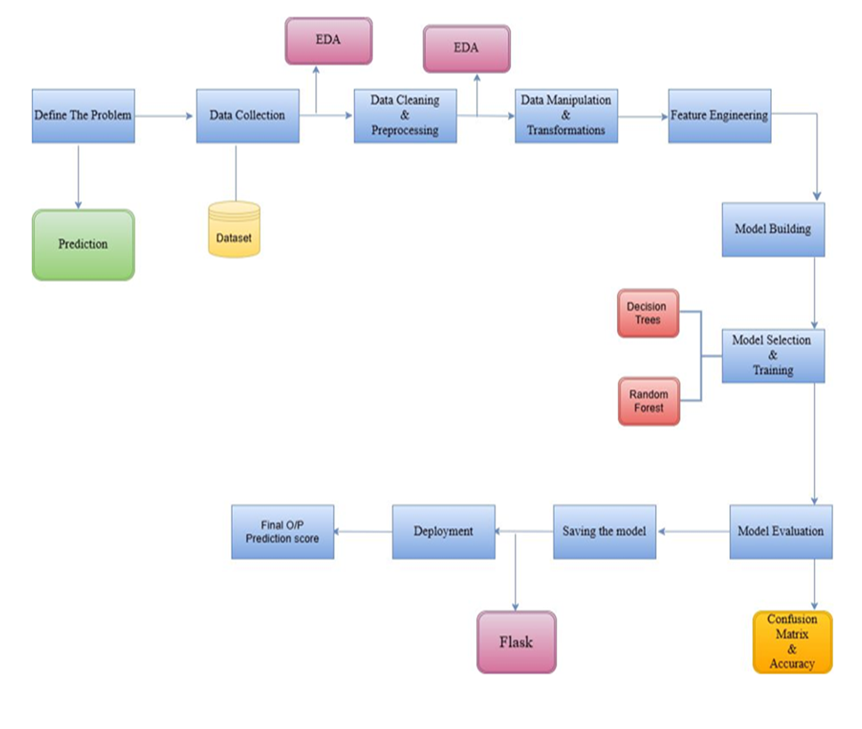
ARCHITECTURAL DIAGRAM:

Slide 8
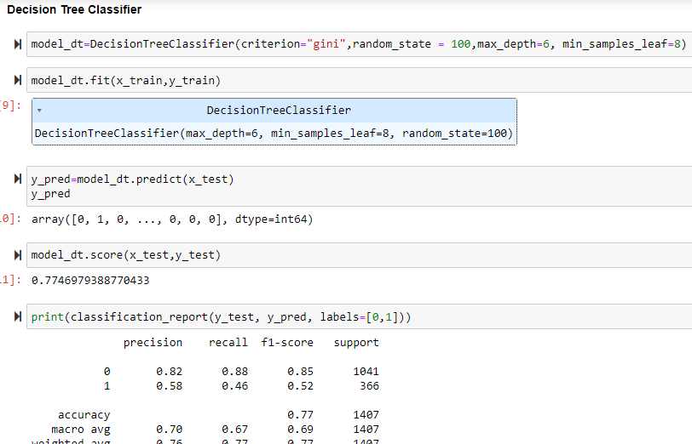
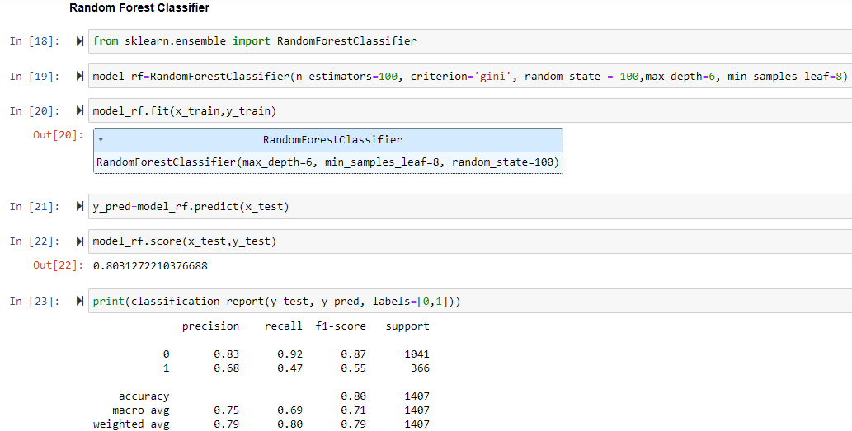
MODULES:

Slide 9
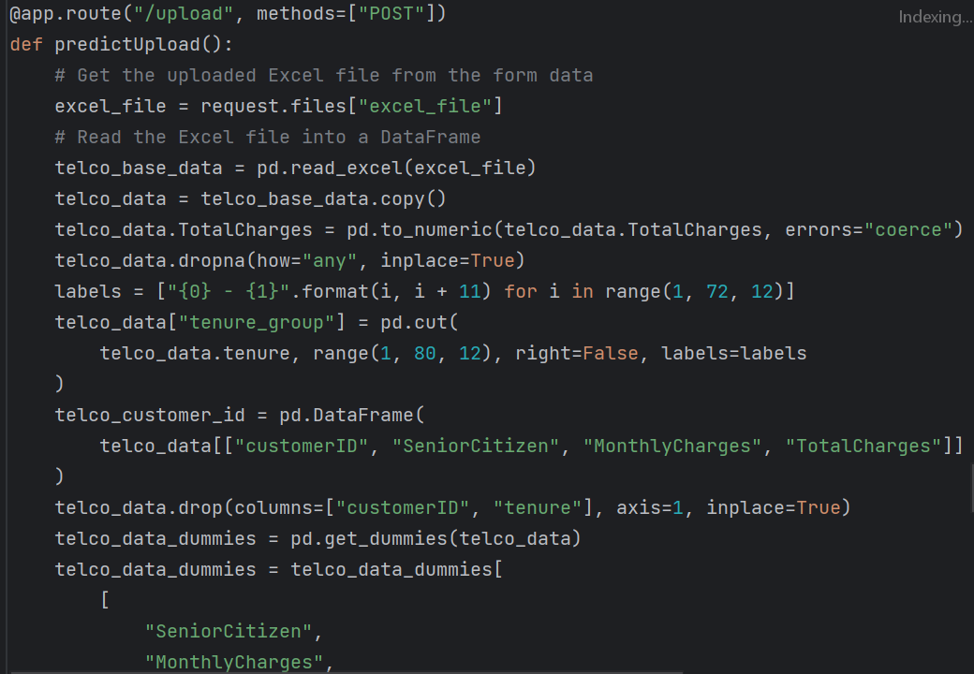
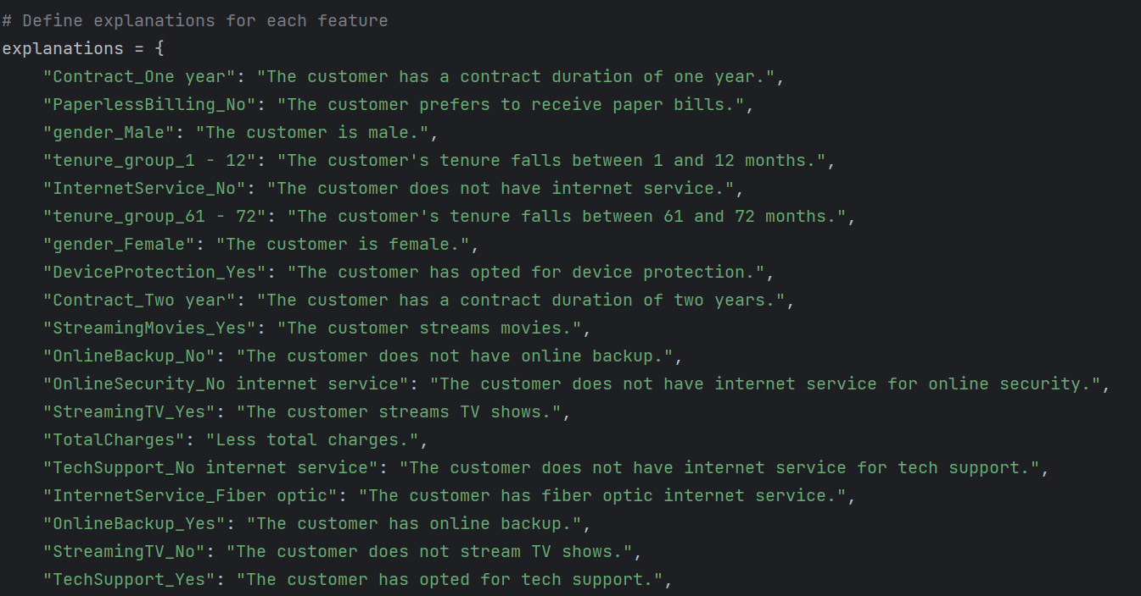
App.py:

Slide 10
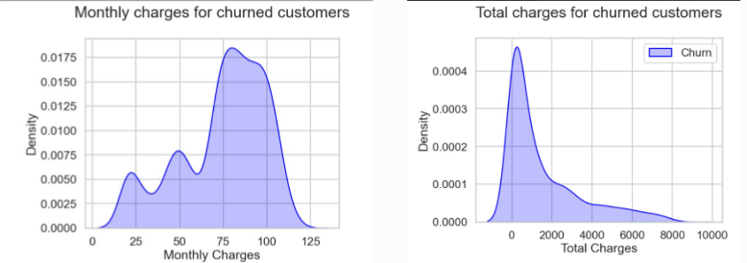
IMPLEMENTATION:

Slide 11
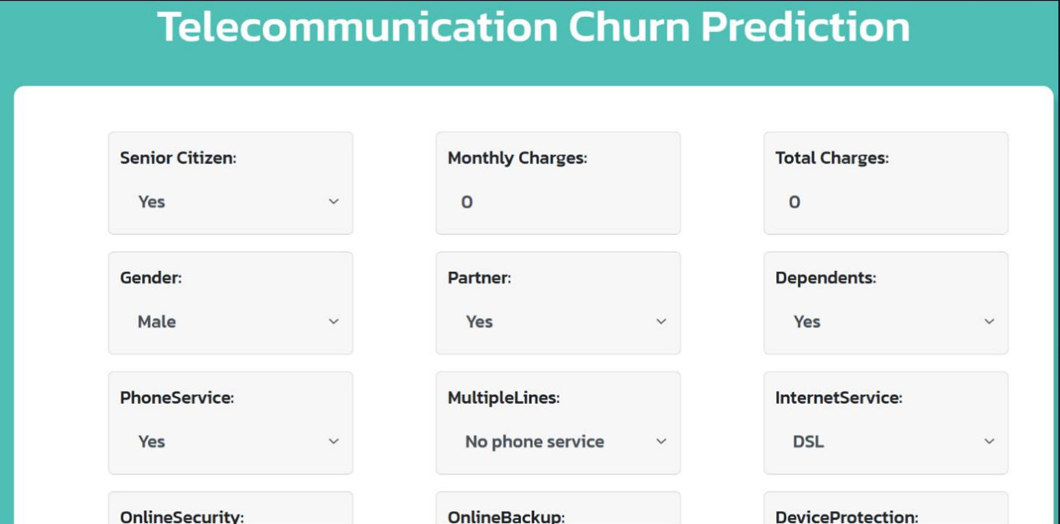
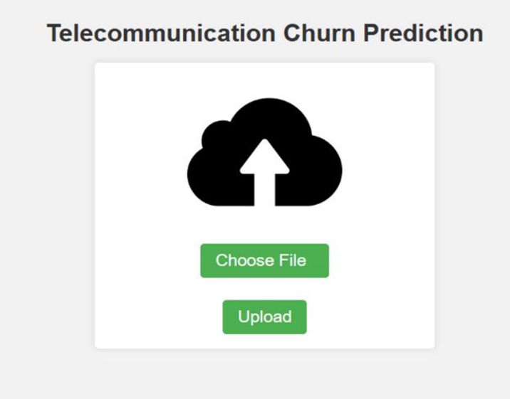
OUTPUT:

Slide 12
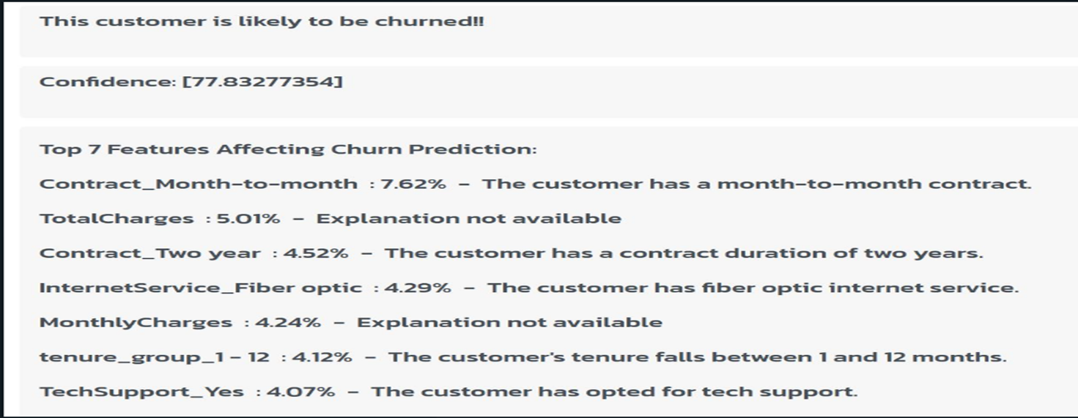
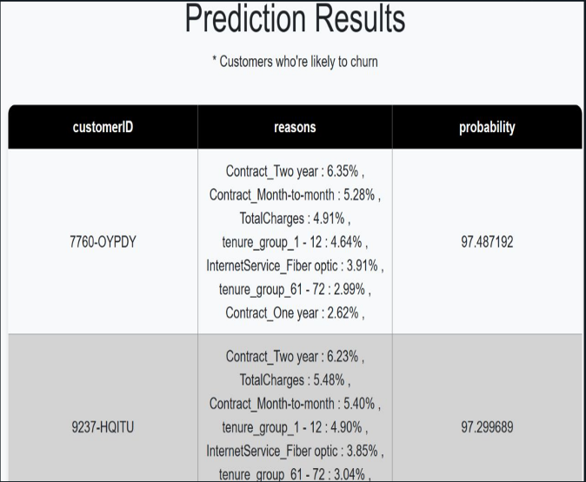

Slide 13
REFERENCES:
[1] J. Latheef and S. Vineetha, "LSTM Model to Predict Customer Churn in Banking Sector with SMOTE Data Preprocessing," 2021 2nd International Conference on Advances in Computing, Communication, Embedded and Secure Systems (ACCESS), Ernakulam, India, 2021, pp. 86-90, doi: 10.1109/ACCESS51619.2021.9563347.
[2] A. Larasati, D. Ramadhanti, Y. W. Chen and A. Muid, "Optimizing Deep Learning ANN Model to Predict Customer Churn," 2021 7th International Conference on Electrical, Electronics and Information Engineering (ICEEIE), Malang, Indonesia, 2021, pp. 1-5, doi: 10.1109/ICEEIE52663.2021.9616714.
[3] X. Zhang, G. Feng and H. Hui, "Customer-Churn Research Based on Customer Segmentation," 2009 International Conference on Electronic Commerce and Business Intelligence, Beijing, China, 2009, pp. 443-446, doi: 10.1109/ECBI.2009.86.
[4] Peng Li, Siben Li, Tingting Bi and Yang Liu, "Telecom customer churn prediction method based on cluster stratified sampling logistic regression," International Conference on Software Intelligence Technologies and Applications & International Conference on Frontiers of Internet of Things 2014, Hsinchu, 2014, pp. 282-287, doi: 10.1049/cp.2014.1576.
[5] Carl Gold, "Fighting Churn with Data: The Science and Strategy of Customer Retention," Manning, 2020.
[6] B. Bardük, "Modelling Time Statistics for Customer Churn Prediction," 2020 28th Signal Processing and Communications Applications Conference (SIU), Gaziantep, Turkey, 2020, pp. 1-4, doi: 10.1109/SIU49456.2020.9302329.

Slide 14
THANK YOU

